Slide 1
JSP/Servlets

Slide 2
Web Servers

Slide 3

What is a Web Server?
A server program that listens on a standard port and handles http protocol.
http protocol consists mainly of requests for documents + upload of file data.
Content type usually html files, text, audio clips, images, etc.
Two most important http protocol elements:
  GET (request document, may upload data)
  POST (request document, upload data).
This protocol is typically hidden from you by browser

Slide 4
http protocol
Most common elements of http protocol:
  GET, PUT
Example
  GET /path/to/file/index.html HTTP/1.0
What does server return?
  Status line: HTTP/1.0 200 OK
  Header line: "Header-Name: value“
    46 headers defined (host, browser, from, etc.)
  Message body: Content-type/Content-length
  text/html, text/gif, etc.

Slide 5
Using telnet to experiment with http
Telnet is an application that allows you to pass arbitrary commands to a specified server.
To connect to a web server:
  telnet whatever.whatever.com 80
Once connect try some http commands:
  GET /path/to/file.html HTTP1.0
Do some experiments like this to get a feel for the protocol

Slide 6
Role of web browser
Web browser hides this protocol underneath a nice GUI.
Web browser also responsible for displaying content sent back by server – text, html, images, audio.
Broswer must handle server error messages in some elegant way. What errors might be handled by web client itself?

Slide 7
“Stateless” protocol
When http server receives connection, it listens for request, sends response, and then closes connection.
Protocols which allow only a single request per session are called “stateless”.
That is, there is no inherent memory from one connection to the next of the previous action.

Slide 8
Early Web Servers
Earliest web sites were static, acted more like file servers:
  Browser requests page
  Server hands over page
  Browser interprets html and displays to user
  Might contain gif or jpeg images or simple animations

Slide 9
Modern Web Servers
Why did this change?
E-Commerce became popular: need then arose for web pages to act more like client-server programs that could interact with user.
On client side, this led to need for higher-end client capabalities:
  Java applets
  DHTML (css, xml, javascript, etc).
  Increased form support in http
  multimedia (flash, etc.)

Slide 10
Modern web servers, cont.
On server side, this led to:
  dynamic web pages – asp, jsp, servlets, Cold Fusion, PHP, etc.
  improvements in cgi

Slide 11
Modern Web Servers, cont.
Problems with client-side processing:
  Slow, must download .class files in case of applet
  Notoriously non-portable
  Could not easily access back-end databases.
Bottom line – good for some things but not the final word.

Slide 12
Server-side programming

Slide 13
Server-side programming
CGI (Common Gateway Interface) scripts defined a standard for extending functionality
  http GET/POST data could be passed to and processed in separate function written in any language (C, Perl, Python most typical)
  This often included call to back-end database and response to user via modified html document
Other standards also exist – ISAPI, etc.

Slide 14
Shortcomings of CGI, etc.
E-Commerce became more popular and web sites became more heavily used. This brought to the fore some shortcomings of CGI:
  New process spawned for every hit – not scalable
  No concept of sesssion or state at software level
  Pretty low level
  Security risks (C in particular)

Slide 15
Servlets
Java’s form of CGI
Relative to CGI, servelets are
  very simple
  Relatively high-level
Requirements: a servlet-enabled web server
When specified by your web page, web page passes http requests to java method (assuming everything is setup properly)

Slide 16
Servlets, cont.
Servlet method then has access to all of Java capabilities – jdbc and EJB very important here.
Finally, Servlet writes html back to user.
Shift in perspective – up until now, we wrote the servers (with help sometimes (e.g. CORBA and rmi) ).
Now, we assume server exists and EXTEND its functionality.

Slide 17
Servlets, cont.
Important: a web server takes care of all interactions with the servlet
On the client side, servlet pages are typically requested in one of two ways:
  As a regular URL address
  As a link in a regular html document
Details are server-dependent

Slide 18
What about the client?
Could write our own http-protocol client, but these also exist already in the form of web browsers
Thus, writing client usually boils down to writing simple html forms
Form data automatically passed as String parameters to servlet
Fancier client capabilities require applet – harder to talk back to server (http tunneling, etc.)

Slide 19
Servlets in J2EE architecture

Slide 20
What is J2EE?
In one sense, a model for how to design multi-tiered (3+) distributed applications
One speaks of a J2EE application being made up of several pieces (we’ll see shortly what these are)
Each piece is installed on different machines depending on its role:
  Client-tier components run on the client machine.
  Web-tier components run on the J2EE server.
  Business-tier components run on the J2EE server.
  EIS-tier software runs on the EIS server

Slide 21
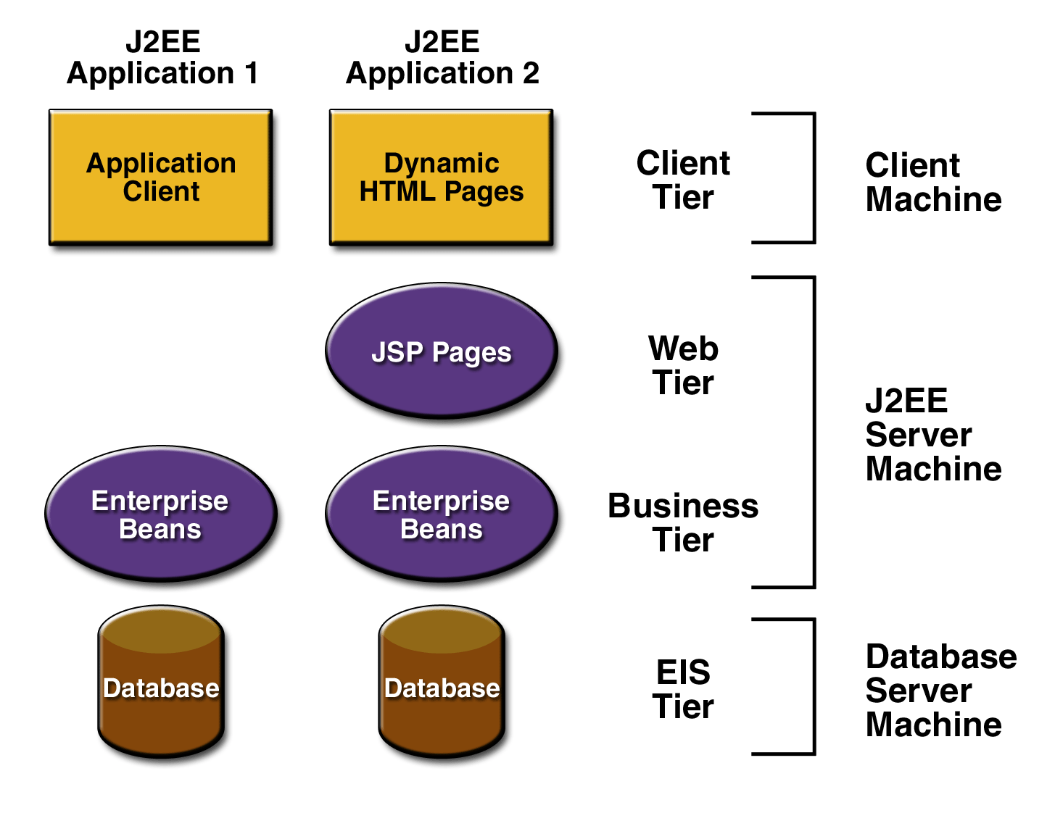
Components of J2EE Application

Slide 22
A few things to remember ...
J2EE is not a product.
J2EE is a specification for a component architecture and associated software that is needed to support it.
Foremost among such tools is a CTM called the J2EE application server.
Implementors supply the J2EE application server (web container + EJB container) + various others tools for configuring, managing, and deploying J2EE applications.

Slide 23
Pieces that makeup J2EE application

Slide 24
J2EE Components
J2EE applications are made up of a number of different components.
A J2EE component is a self-contained functional software unit that is assembled into a J2EE application with its related classes and files and that communicates with other components

Slide 25
Types of J2EE Components
The J2EE specification defines the following J2EE components:
  Application clients and applets are components that run on the client.
  Java Servlet and JavaServer Pages (JSP ) technology components are Web components that run on the server.
  Enterprise JavaBeans (EJB ) components (enterprise beans) are business components that run on the server.

Slide 26
J2EE Clients
Web Clients
  “Thin Clients”: no application logic, database queries, etc.
  Web Browser + HTML | XML, etc.
  “Recommended” technique
  Can include applet if necessary
Application Clients
  Typically Swing when richer user interface is needed
  Typically access server components directly but can use http with web server

Slide 27
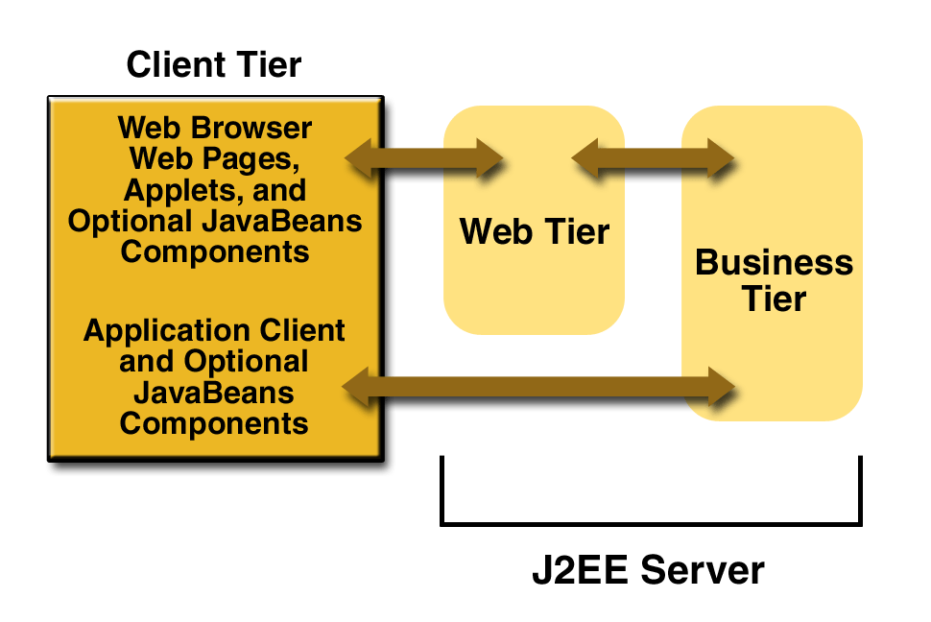
J2EE Clients

Slide 28
Web Components
Either JSP pages or Servlets
Regular html pages not strictly considered Web Components by J2EE standard
However, html + support classes typically bundled with Web Coponents
Where do JavaBeans fit in?

Slide 29
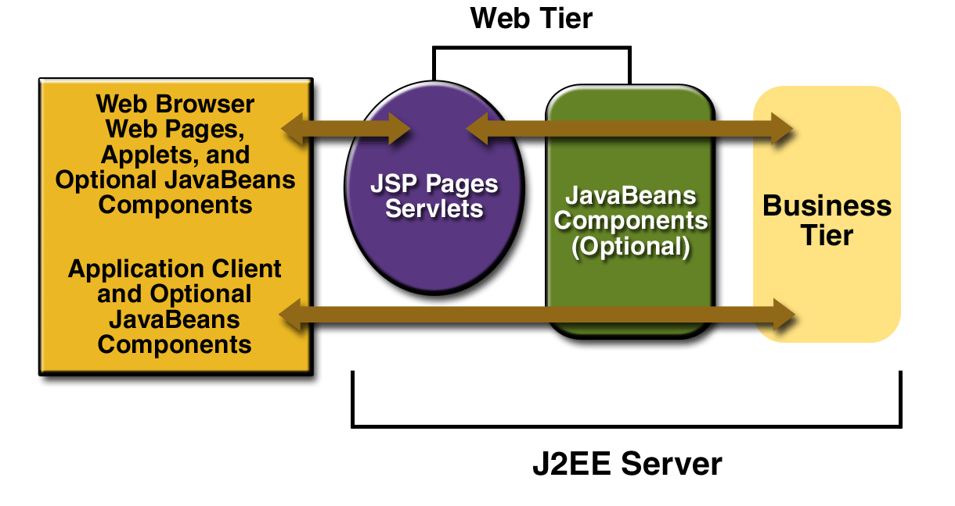
Another J2EE View

Slide 30
Mechanics of Writing Servlets

Slide 31
How do I write a Servlet?
First, must have some implementation of the java Servlet API (so that you can import the proper classes).
This does not come with Java 2 SDK, Standard Edition.
It does come with Java 2 SDK, Enterprise Edition (aka J2EE).

Slide 32
Writing Servlets, cont.
For servlets (and JSP), Sun’s principle reference implementation is called Tomcat (www.jakarta.org)
Of course, dozens of vendors supply their own implementation – WebSphere, WebLogic, Jbuilder, etc.

Slide 33
Local Servlet Engine
We have installed a Servlet-enabled web server on tomcat-cspp.cs.uchicago.edu
  See accompanying notes in dropbox
It is my _hope_ that we can do all of our work on this and not have to have each person setup their own tomcat locally.
However, there are glitches and we don’t have a professional administrator, so no promises!

Slide 34
Writing Servlets, cont.
All servlets extend the Servlet class.
All http servlets (by far most typical) should extend the HttpServlet class.
In extending HttpServlet, you typically override the following methods:
  init, service or doGet/doPost, destroy (very common)
  doPut, doDelete, doOptions, doTrace (rare)
Note: there is NO main() for Servlets!

Slide 35
Main HttpServlet Methods
init()
  called once when servlet is loaded by server. Contains any initializations that are common to all requests.
doGet(HttpServletRequest, HttpServletResponse)
  Called each time the servlet receives an http GET request posted by a client. Passes two objects, one representing the information of the request, the other used to configure a response. We’ll study these methods soon.

Slide 36
Main HttpServlet Methods, cont.
doPost(HttpServletRequest, HttpServletResponse)
  Same as doGet but for an http POST request.
destroy()
  Called before servlet is unloaded from memory. Performs any final cleanup, freeing memory, closing connections, etc.

Slide 37
Service Method
Important: The method service(HttpServletRequest,HttpServletResponse)
is also called for each servlet invocation.
service() in turn calls doGet and doPost, etc. for an HttpServlet.
It is best not to override service even if you want to handle doGet() and doPost() identically. Simply have one call the other.

Slide 38
HttpServletRequest Object
Passed when browser calls doGet and doPost.
Most import methods for beginning servlet programming (in HttpServletRequest class):
  String getParameter(String paramName)
  String[] getParameterNames()
  String[] getParameterValues()
Makes getting data from web pages very simple.
Many other methods for images, cookies, etc.

Slide 39
HttpServletResponse Object
Passed when browser calls doGet or doPost
Most import methods for beginning servlet programming:
  PrintWriter getWriter();
    Get Writer for communicating back to client
  setContentType(String);
    Typically use “text/html”, indicating that html will be sent back to the browser

Slide 40
Examples

Slide 41
General Comments
Recall that each request for a servlet gets its own thread but accesses the same methods. Thus, synchronization issues arise.
Writing html to java stream is ugliest thing ever.
Many more servlet classes for having fun. Can’t possibly cover all in one course, but most are very simple.
See http://www.coreservlets.com for more

Slide 42
What is JSP?
JSP – Java Server Pages
Can be used:
  As alternative to servlets
  In combination with servlets
Simplifies ugly aspect of servlet programming (ie writing html to the stream).
Allows you to mix Java code directly with html – output gets sent to stream automatically.

Slide 43
JSP: Making dynamic web content easier

Slide 44
Popular Competing Technologies
Microsoft Active Server Pages (ASP)
  Very popular and easy
  Locks you into Windows IIS
Perl Hypertext Preprocessor (PHP)
  Easy and powerful for certain types of apps
  More one-dimensional than java backend world
Adobe Cold Fusion
  Proprietary

Slide 45
Writing JSP
JSP scripting elements inserted directly into html document
Three types of scripting elements
  Expressions: <%= expression %>
  Scriptlets: <% code %>
  Declarations <%! code %>

Slide 46
JSP Scripting Elements
Note: JSP files are translated to servlets behind the scenes. Knowing this isn’t really necessary but it helps to understand how the JSP scripting elements work:
Expressions are evaluated and automatically placed in the servlet’s output. (ie no need for out.println!).

Slide 47
JSP Scripting Elements, cont.
Scriptlets are inserted into the servlet’s _jspService method (called by service).
Declarations are inserted into the body of the servlet class, outside of any methods.
Any regular html is just “passed through” to the client.

Slide 48
JSP Expressions
<= Java Expression %>
  The expression is evaluated when the page is requested, converted to String, and inserted in the web page.
Simple example:
  Current time: <%= new java.util.Date() %>

Slide 49
JSP Expressions, cont.
To simplify expressions JSP comes with a number of pre-defined objects. Some important ones are:
  Request
  Response
  Session
  Out
Example
  Your hostname: <%= request.getRemoteHost() %>

Slide 50
JSP Scriptlets
<% Java Code %>
If you want to do something more complex than insert a simple expression.
Example:
  <%
  String queryData = request.getQueryString();
  out.println(“Attached GET data: “ + queryData);
  %>

Slide 51
Using Scriptlets for conditional output
Scriptlets are often used to conditionally include standard JSP and html constructs.
Example
  <% if (Math.random() < 0.5) { %>
    Have a <B>nice</B> day!
    <% else { %>
    Have a <B>lousy<B/> day!
    <% } %>

Slide 52
Conditional output, cont.
This is converted to the following servlet code:
  if (Math.random() < 0.5) {
  out.prinltn(“Have a <B>nice</B> day!”);
  }
  else{
  out.println(“Have a <B>lousy</B> day!”);
  }

Slide 53
JSP Declarations
<%! Java Code %>
Define methods and fields inserted into main body of servlet class
Declarations do not generate output
  Normally used in conjunction with scriptlets and expressions
Example
  <%! Private int accessCount = 0; %>
  Accesses to page since server reboot:
  <%= ++accessCount %>

Slide 54
Additional JSP/Servlet features useful for homework
Forwarding from a servlet to a jsp page (common)
Forwarding from a jsp page to a servlet (not so common) or jsp (more common)
Session Tracking

Slide 55
Forwarding from Servlet to JSP
Very useful when processing result requires dramatically different presentation to be sent to user
From within servlet
  String url = “/store/login.jsp”;
  RequestDispatcher dispatcher =
  getServletContext().getRequestDispatcher(url);
  dispatcher.forward(req, res) //pass control to new url
  dispatcher.include (req, res) //include contents of url

Slide 56
Forwarding from JSP
<jsp:forward> page = “Relative URL”/>
Example:
<% String destination;
if (Math.random() > .5){
destination = “/examples/page1.jsp”;
} else {
destination = “/examples/page2.jsp”;
%>
<jsp:forward page=“<%= destination %>” />

Slide 57
Session Tracking
HTTP is a “stateless” protocol
No built-in mechanism to determine whether a request is associated with a user who has recently issued previous requests.
Typically handled in one of several ways.
  Cookies: write info to users disk and retrieve to identify
  Hidden Fields, URL-rewriting, etc. (not as good).
Session Tracking API
  Layered on top of above mechanisms

Slide 58
Session Tracking mechanics
HttpSession s = request.getSession(true)
  Returns session object if request is part of a session, otherwise creates a new session object.
  Use isNew() to determine if sesssion is new.
  Useful Methods for homework
  public Object getValue(String name);
  public setValue(String name, Object value);
  public long getLastAccessedTime();

